Slide 1

SARI
Haze Removal
Shanghai Advanced Research Institude
Reporter：王恒

Slide 2
1
Background
目录
2
Steps & Codes
CONTENTS
3
Results & Analysis

Slide 3
第一部分
Background

Slide 4





Dark Channel
Haze Image
Guided Filter
q=p-n

Slide 5
第二部分
Steps & Codes

Slide 6
Steps:
Get Dark Channel
Get Atmospheric Light
Estimate the t
and guide filter
Recover Image

Slide 7
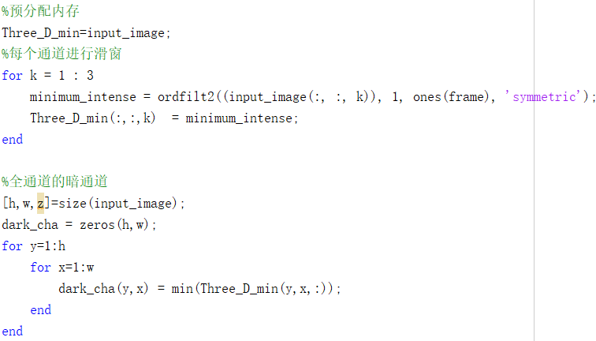
Get Dark Channel

Slide 8

Get Atmospheric Light
The paper said: “We first pick the top 0.1% brightest pixels in the dark channel. These pixels are most haze opaque. Among these pixels, the pixels with highest intensity in the input image I is selected as the atmospheric light.”

Slide 9
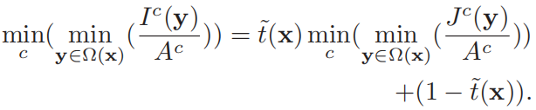



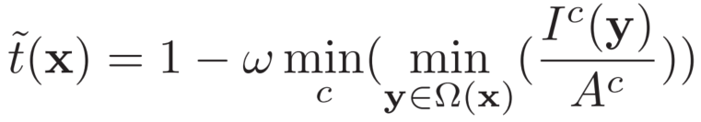
Estimate the t

Slide 10
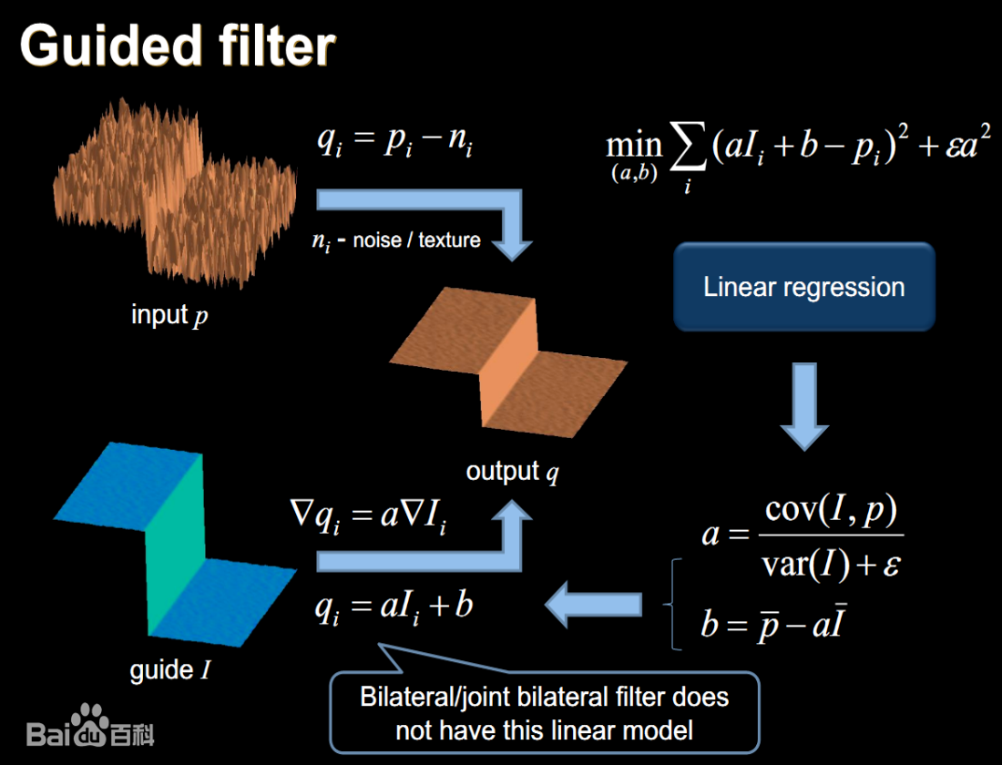
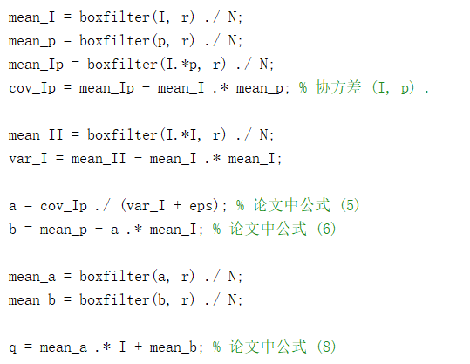
After guide filtering

Slide 11

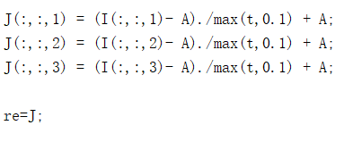
Recover Image
The paper said :A typical value of t₀ is 0.1.

Slide 12
第三部分
Results & Analysis

Slide 13
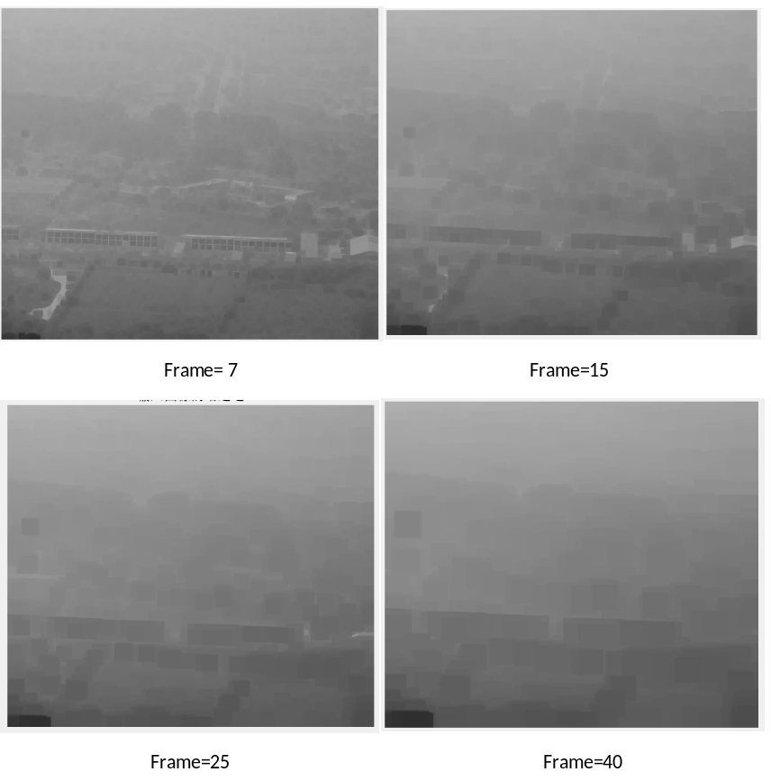
Size of Dark Channel Windows:
The frame of windows influence the results of dark channel. The more large the window is, the more blurry the image is. However it also need more time to compute. So, when we need more details, we should use small windows to process. If we wanted to compute faster, we need to choose large window.

Slide 14
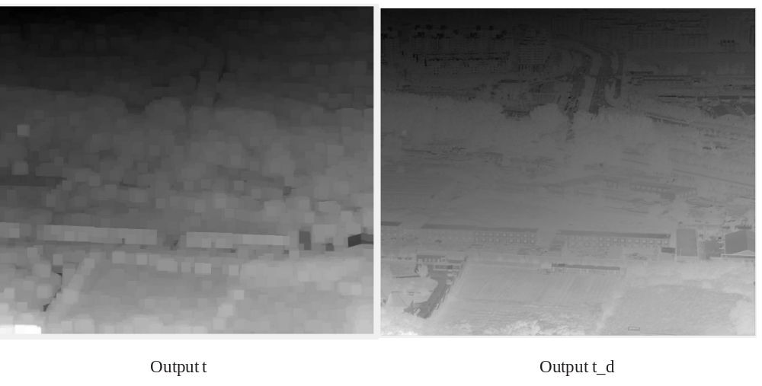
Compare t with t_d
Output t is computed directly by dark channel and airlight. Output t_d is computed by guide filtering. It's obvious that the output t_d is much better than output t. Output t_d's edge is more clear, the guide filter eliminate noise to make the edge clear.

Slide 15
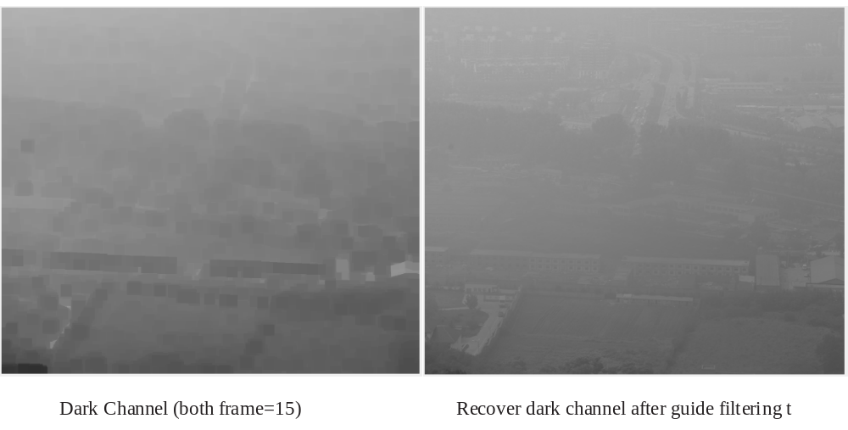
Compare Dark Channel with Dark Channel after Guide Filtering t
The dark channel result is much better after guide filtering t. I recover the new dark channel by guide filtering t. Guide filter recover input image and eliminate noise to make the dark channel more clear.

Slide 16
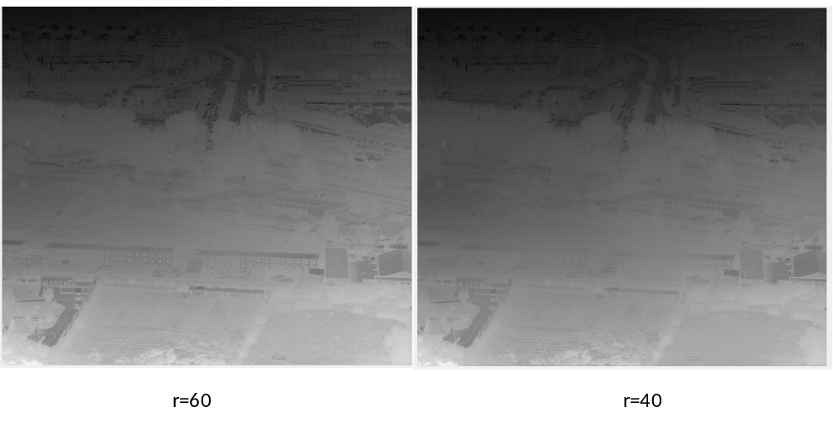
Guide Filter's Radius of Windows
When radius is 60, the output t_d has more detail than when radius is 40. Because when make guide filter, we need to do regression. When we choose a larger place, the “line” could classify more pixels, and make the noise small.

Slide 17
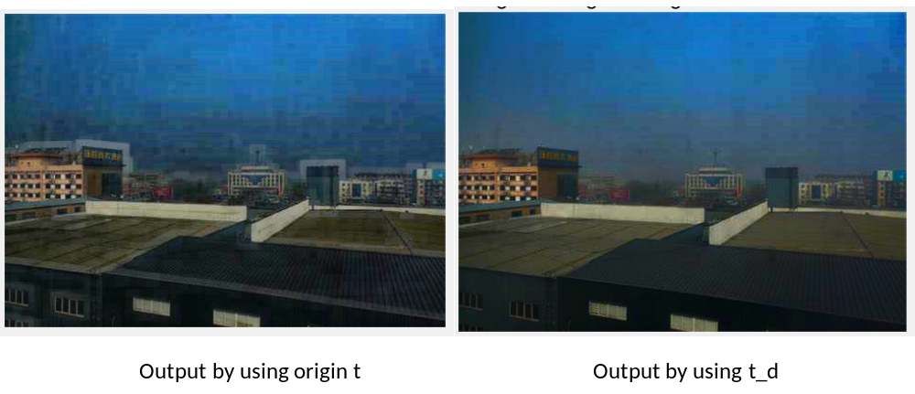
Final output
Output by using t, the scene of buildings have more blurry edge, the details of output by using t_d are more clear than using t. When using guide filter, the t_d is linear with I, so when output J is that I divided by t_d. It is the input image that caused output.

Slide 18
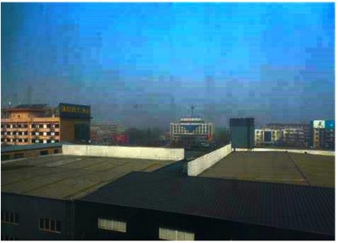
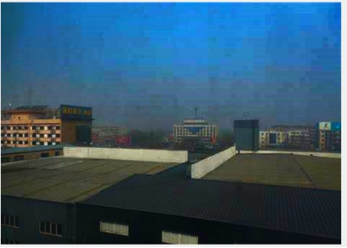
Airlight
Airlight= Max(dark channel)=160 fix figure Airlight=170
Output by using max dark channel, the sky of picture are brighter than using fix figure airlight. But the sky is not smoothness. It is (I-A)/t and t<1, when I>A the output will be much large and the picture will be more bright, but if I near A, the output would not be much large, the picture will be normal. The reason why sky so different might be the original picture I.

Slide 19



